Slide 1
Chapter-5
Strategy and Applications
E-Procurement
E-Marketing
Customer Relationship Management (CRM)

Slide 2
Learning outcomes
Identify the benefits and risks of e-procurement
Analyze procurement methods to evaluate cost savings
Assess different options for integration of organizations’ information systems with e-procurement suppliers.
Management issues
What benefits and risks are associated with e-procurement?
Which method(s) of e-procurement should we adopt?
What organizational and technical issues are involved in introducing e-procurement?
How important is procurement?
We estimate that for every dollar a company earns in revenue, 50 cents to 55 cents is spent on indirect goods and services – things like office supplies and computer equipment.
That half dollar represents an opportunity: By driving costs out of the purchasing process, companies can increase profits without having to sell more goods. Hildebrand (2002)

Slide 3
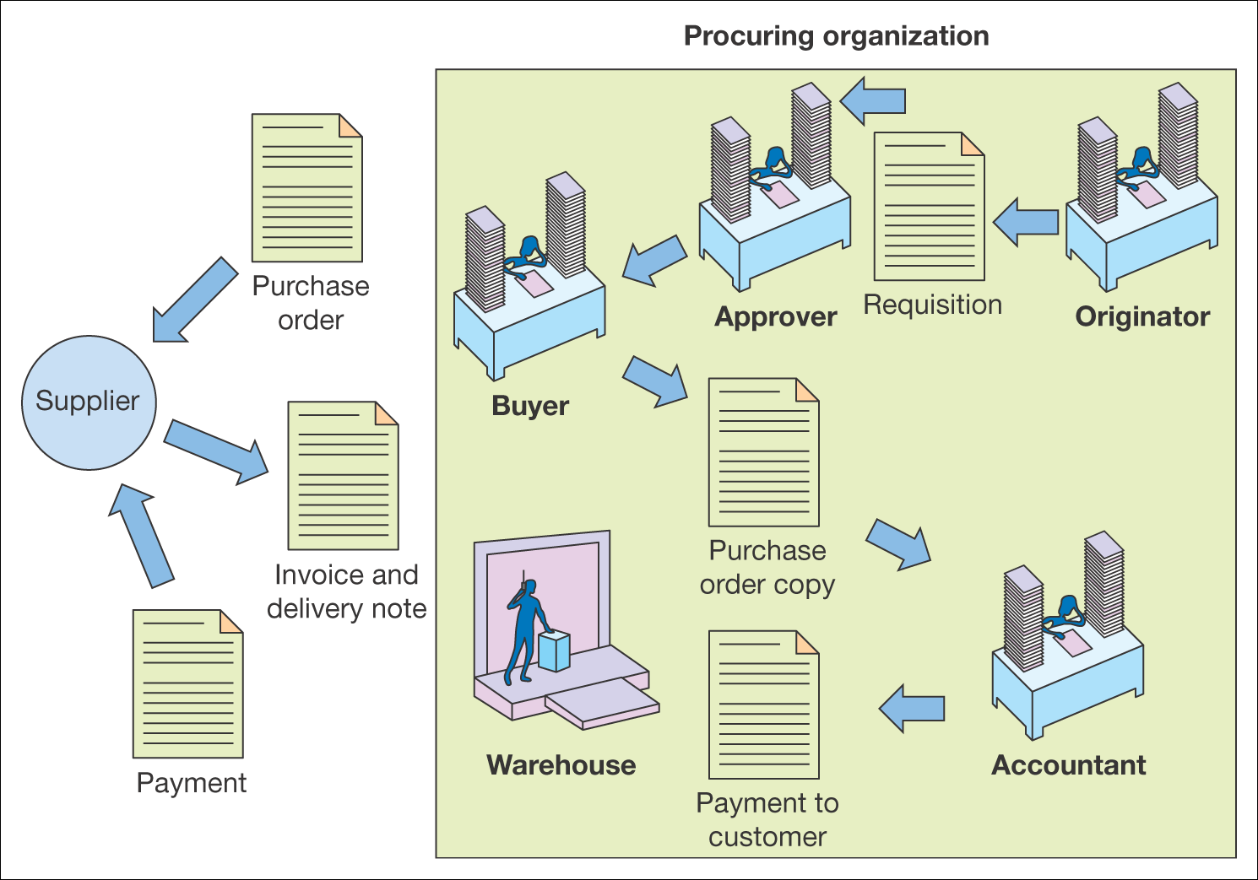
What is e-procurement?
The electronic integration and management of all procurement activities including purchase request, authorization, ordering, delivery and payment between a purchaser and a supplier at the right price
delivered at the right time are of
the right quality of
the right quantity from the right source.
The 5 rights of E-procurement
Figure 7.1 Key procurement activities within an organization

Slide 4
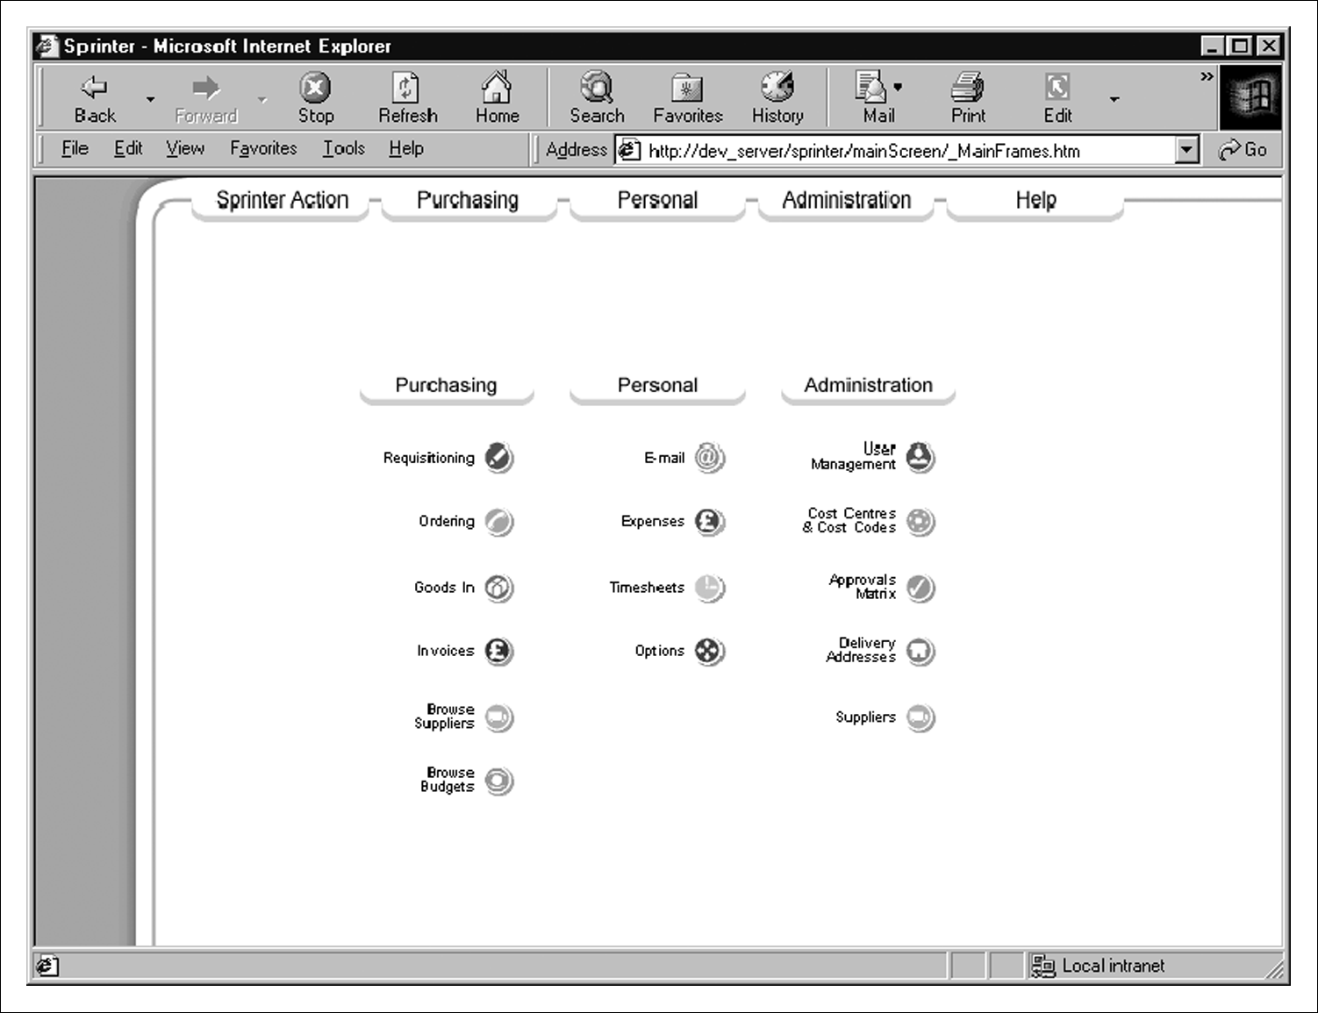
Figure 7.2 Electronic procurement system
Source: Tranmit plc

Slide 5
Types of procurement
Production-related procurement
Non-production related procurement
How items are bought: Systematic sourcing & Spot sourcing
Drives of e-procurement: Cost reduction
Enhanced budgetary control, Elimination of administrative errors
Increasing buyer’s productivity, Improving information management
Improving the payment process
Risks and impact of e-procurement
Organizational risks :Need to redeploy staff
Technology risks : Integration with existing financial systems
Implementing e-procurement
Stock control system, CD/web-based catalogue
E-mail/workflow system, Order-entry on web site
Accounting systems, ERP systems

Slide 6
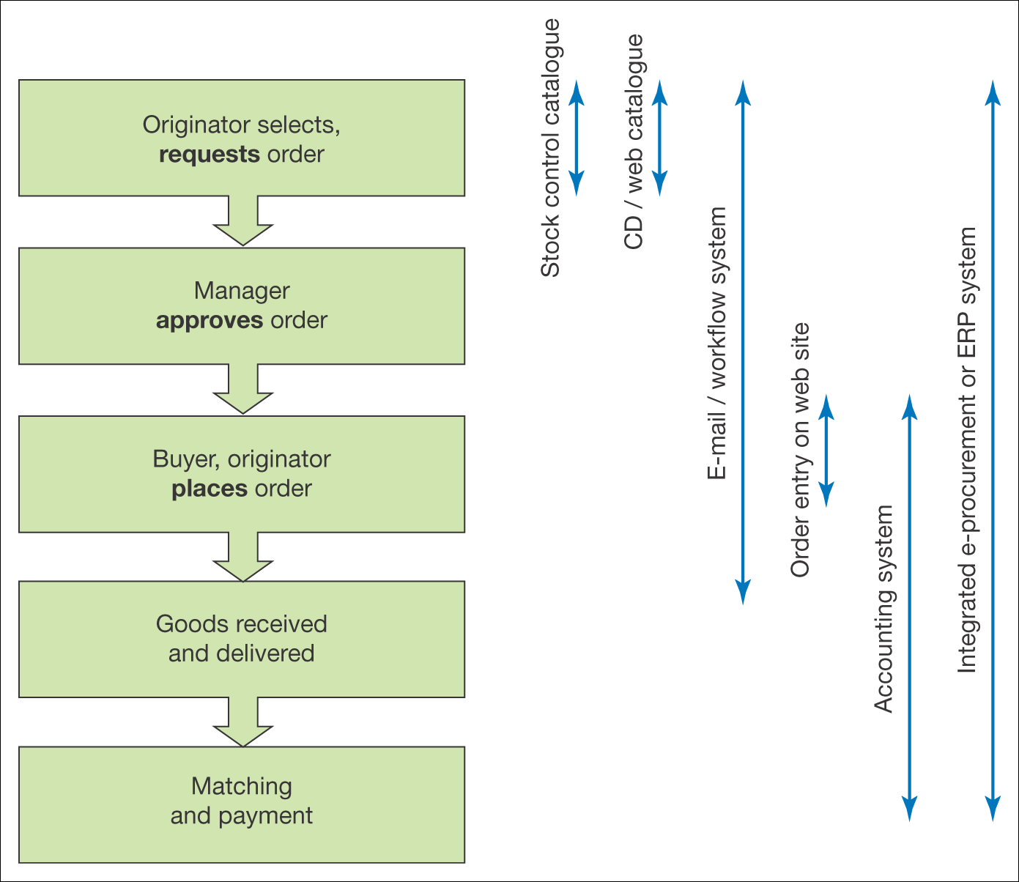
Figure 7.3 Use of different information systems for different aspects of the
fulfilment cycle

Slide 7
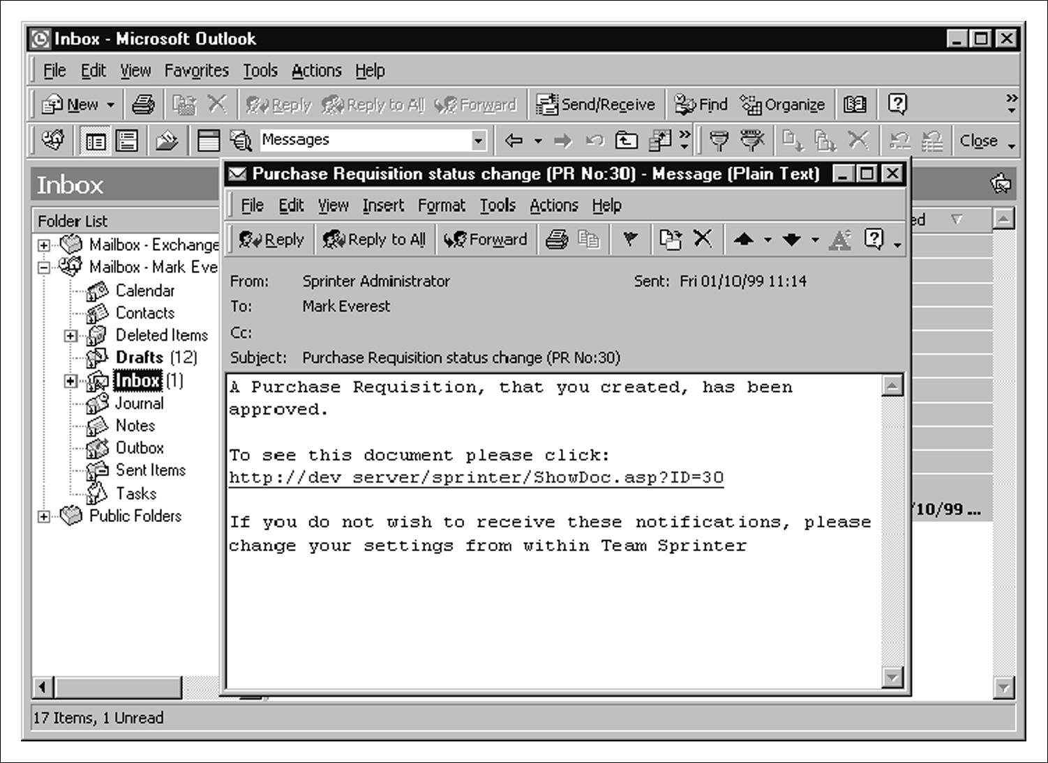
Figure 7.4 E-mail notification of requisition approval
Source: Tranmit plc

Slide 8
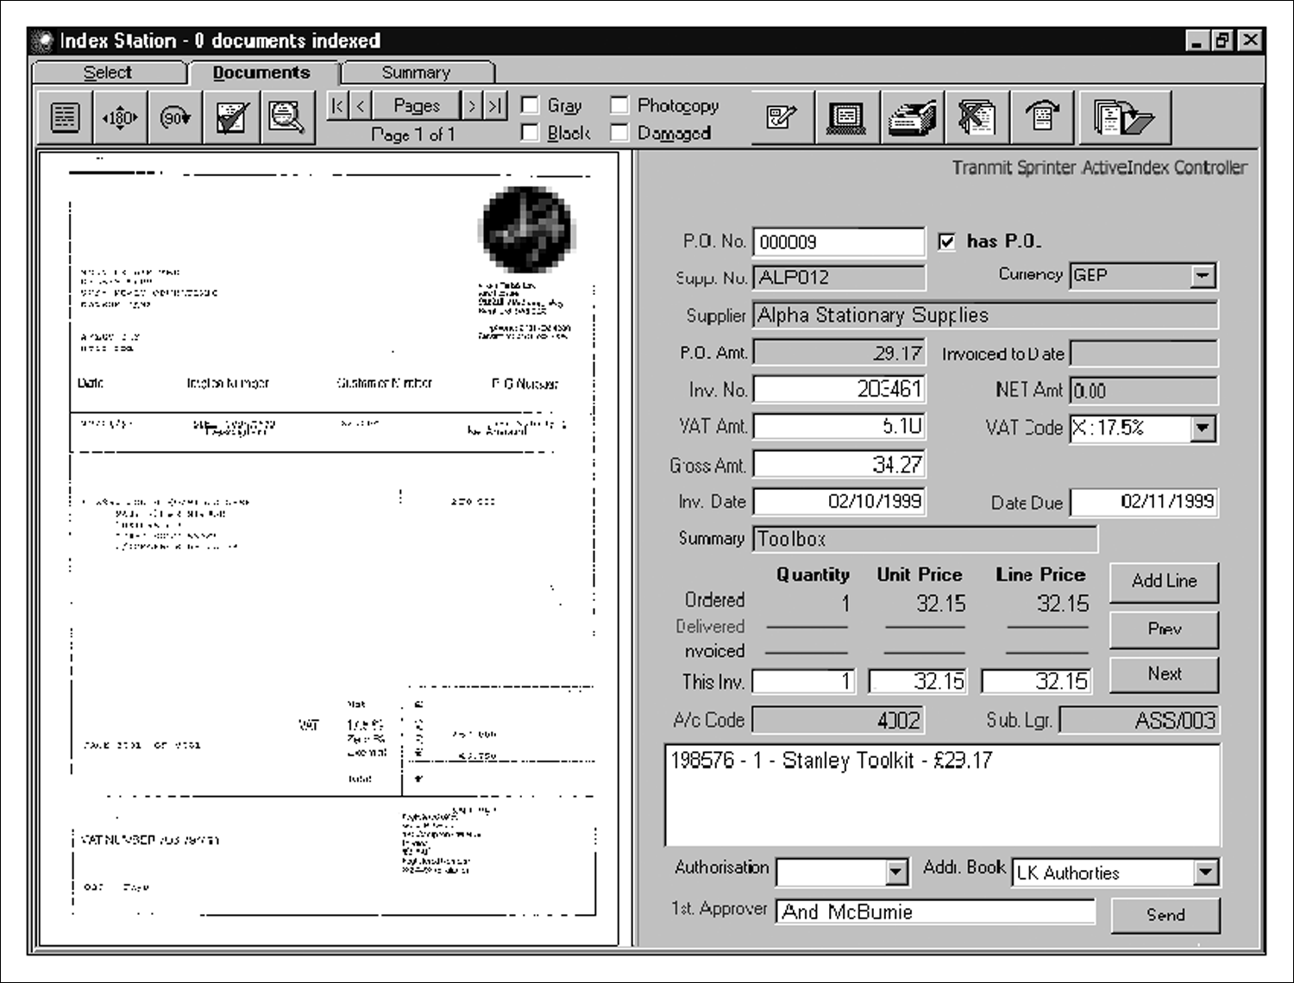
Figure 7.5 Document management software for reconciling supplier invoice with purchase order data
Source: Tranmit plc

Slide 9
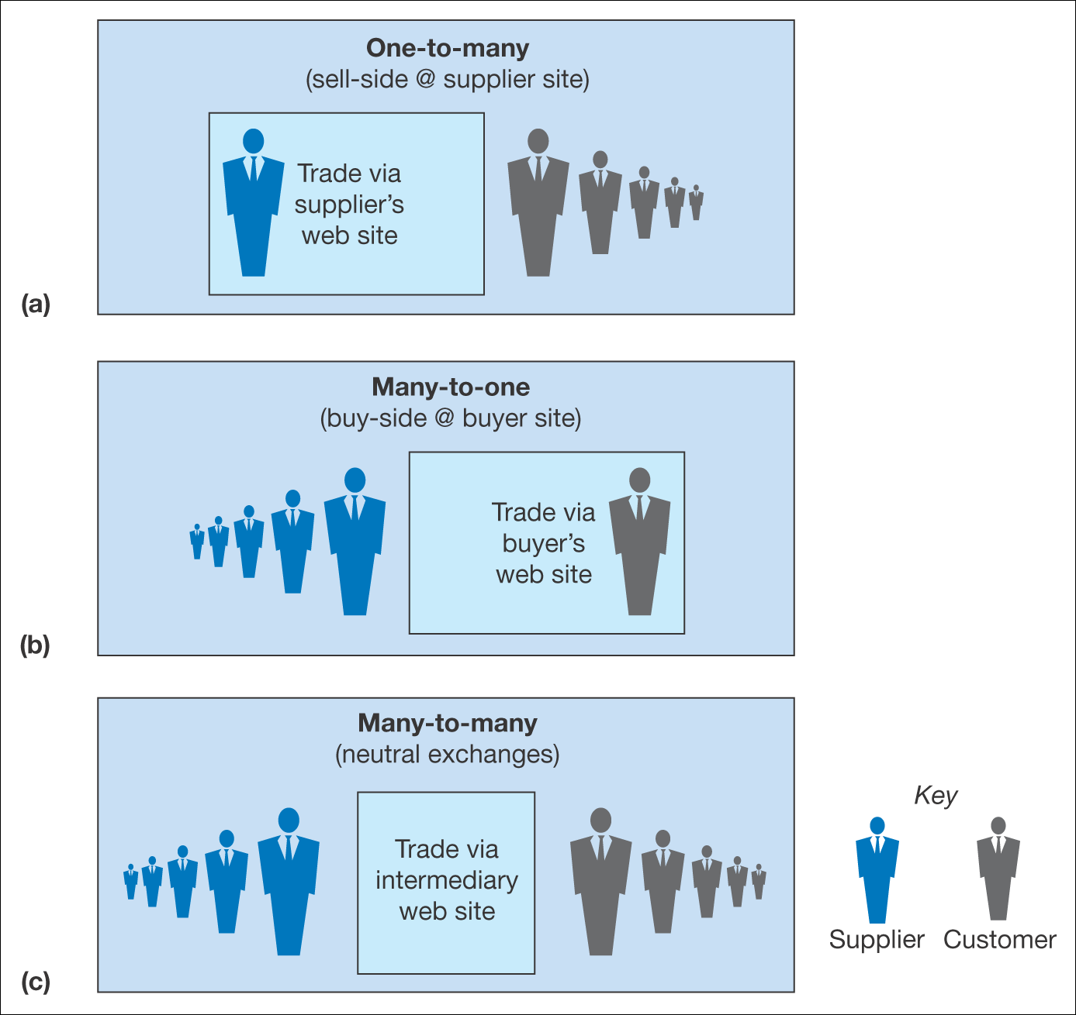
Figure 7.6 The three main e-procurement model alternatives for buyers

Slide 10
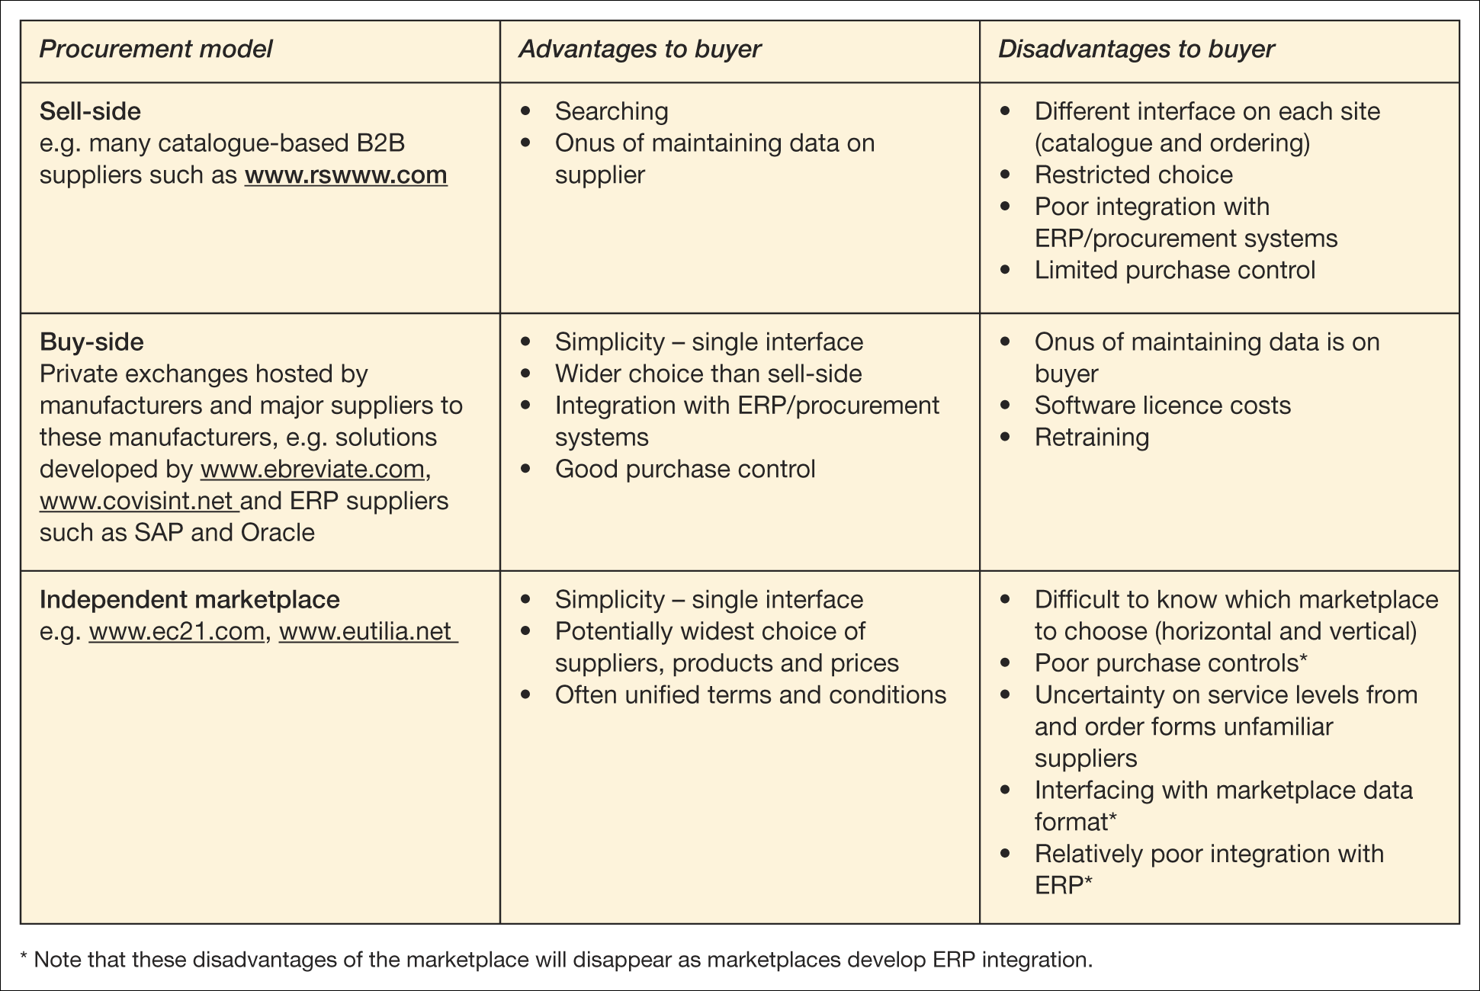
Table 7.6 Assessment of the procurement model alternatives for buyers

Slide 11
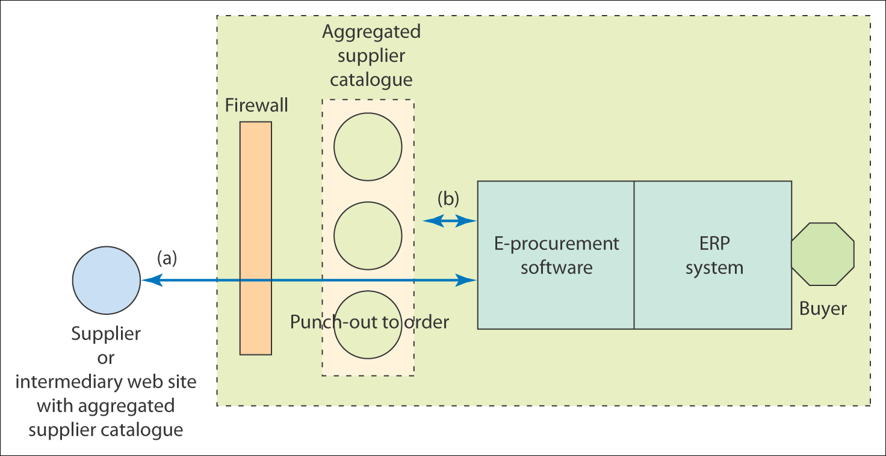
Figure 7.7 Integration between e-procurement systems and catalogue data

Slide 12
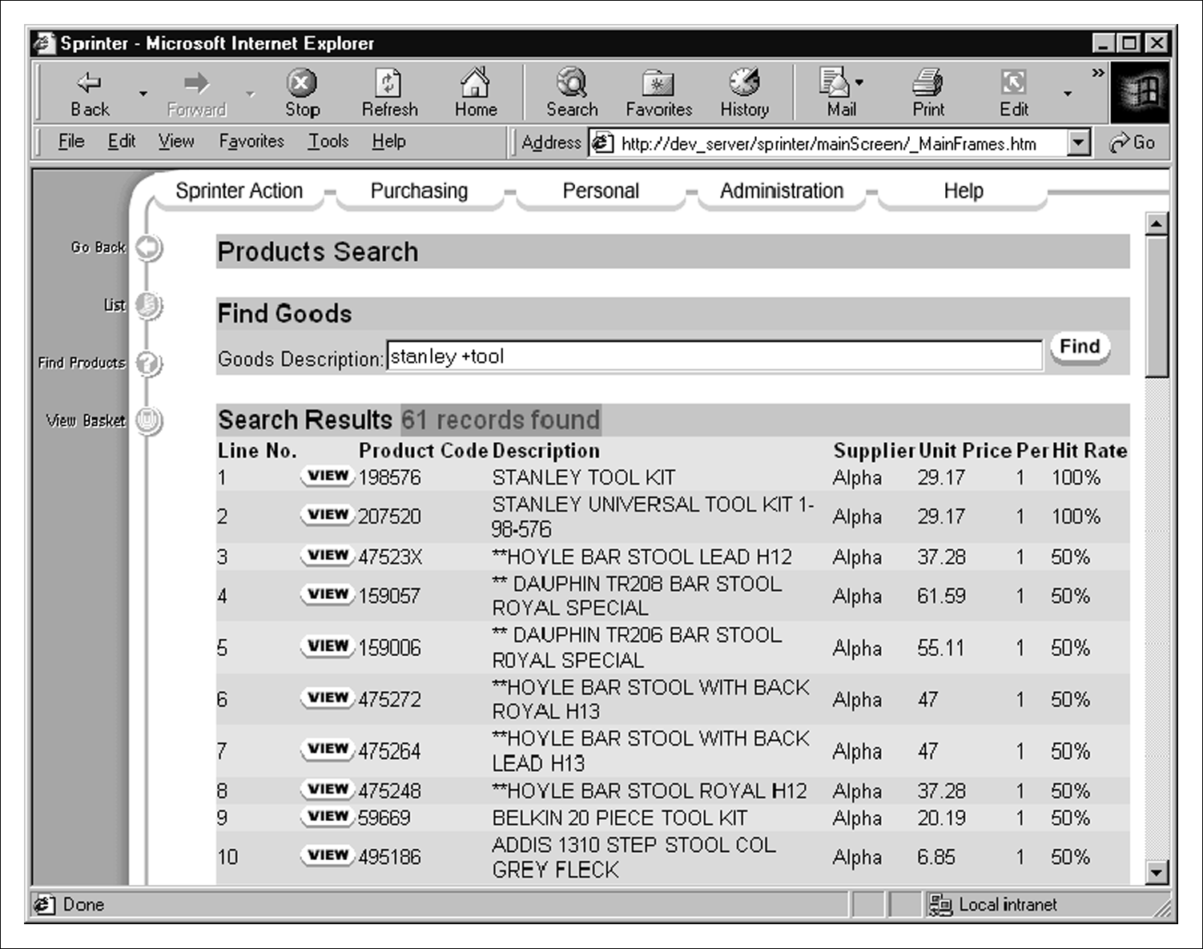
Figure 7.8 An online catalogue of items for purchase
Source: Tranmit plc

Slide 13
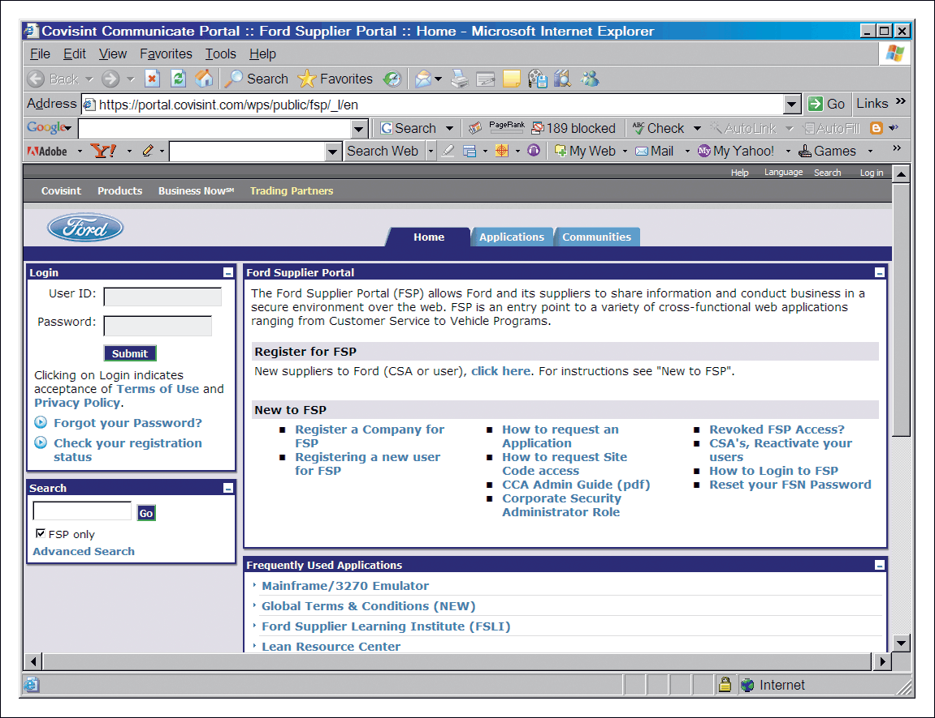
Figure 7.9 Ford supplier portal provided by Covisint
Source: Covisint.com

Slide 14
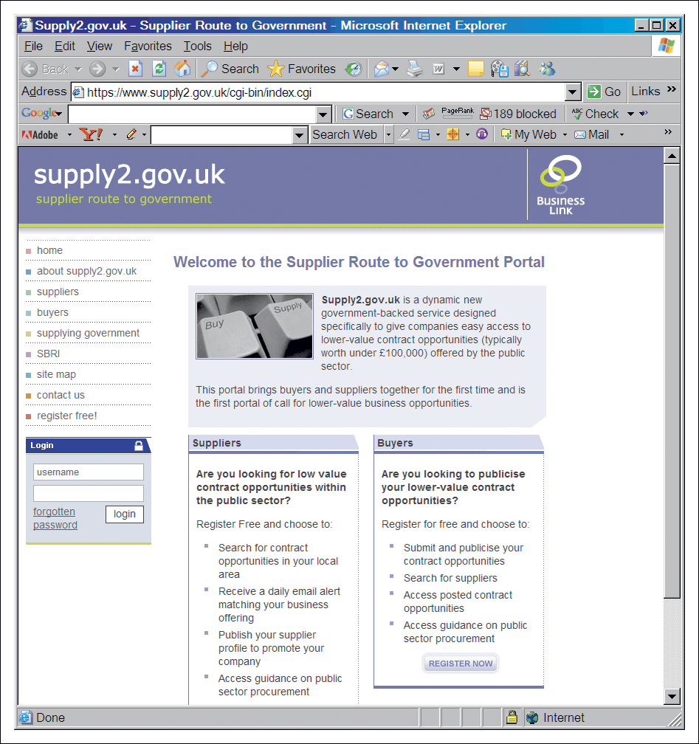
Figure 7.10 Supplier Route to Government Portal (www.supply2.gov.uk)

Slide 15
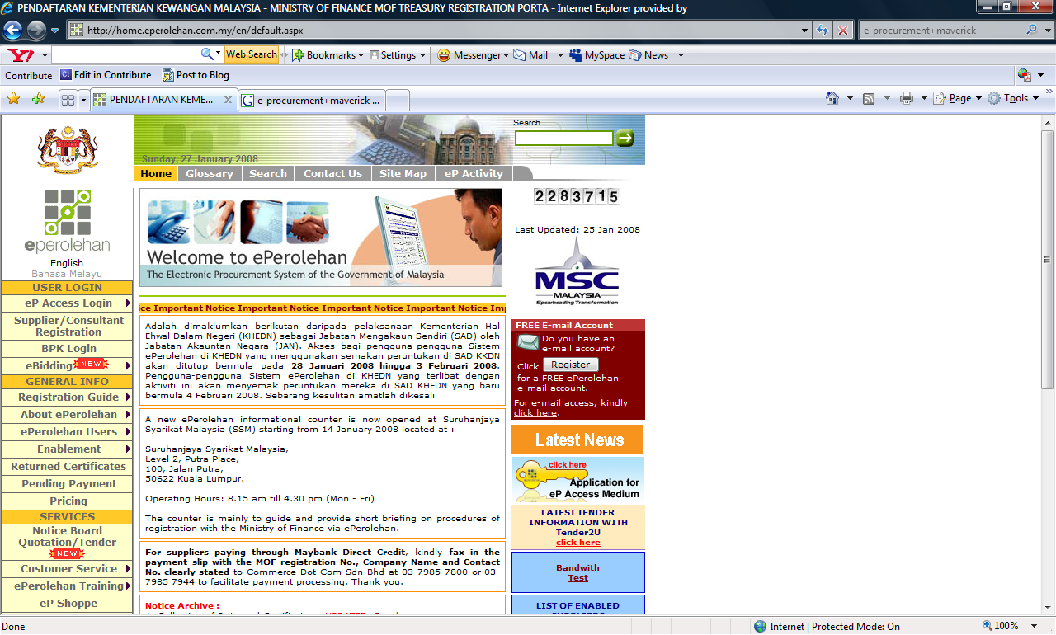
Government marketplace exchanges

Slide 16
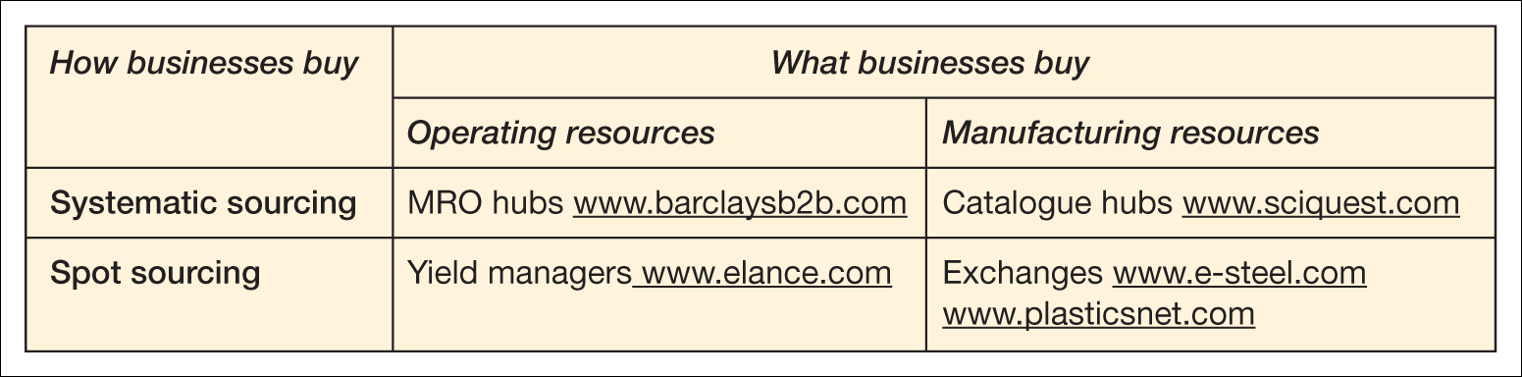
Types of marketplace
Table 7.7 Types of B2B marketplaces identified by Kaplan and Sawhney (2000)
with examples
Identify the benefits and risks of e-procurement
Analyse procurement methods to evaluate cost savings
Assess different options for integration of organizations’ information systems with e-procurement suppliers.

Slide 17
Risks and impact of e-procurement
Organizational risks
  Need to redeploy staff
Technology risks
  Integration with existing financial systems
Implementing e-procurement
Stock control system
CD/web-based catalogue
E-mail/workflow system
Order-entry on web site
Accounting systems
ERP systems

Slide 18
Figure 7.3 Use of different information systems for different aspects of the
fulfilment cycle

Slide 19
Figure 7.4 E-mail notification of requisition approval
Source: Tranmit plc

Slide 20
Figure 7.5 Document management software for reconciling supplier invoice with purchase order data
Source: Tranmit plc

Slide 21
Figure 7.6 The three main e-procurement model alternatives for buyers

Slide 22
Table 7.6 Assessment of the procurement model alternatives for buyers

Slide 23
Figure 7.7 Integration between e-procurement systems and catalogue data

Slide 24
Figure 7.8 An online catalogue of items for purchase
Source: Tranmit plc

Slide 25
Figure 7.9 Ford supplier portal provided by Covisint
Source: Covisint.com

Slide 26
Figure 7.10 Supplier Route to Government Portal (www.supply2.gov.uk)

Slide 27
Government marketplace exchanges

Slide 28
E-Marketing
E-marketing Achieving marketing objectives through use of electronic communications technology.
(a) Electronic business has some degree of overlap with electronic marketing. From the discussion of the marketing concept above we can reject this since both e-business and e-marketing are broad topics.
(b) Electronic business is broadly equivalent to electronic marketing. This is perhaps more realistic, and indeed some marketers would consider e-business and e-marketing to be synonymous.
(c) Electronic marketing is a subset of electronic business. It can be argued that this is most realistic since e-marketing is essentially customer-oriented and it has less emphasis on supply chain and procurement activities in comparison with e-business.

Slide 29
E-Marketing planning
E-marketing plan A plan to achieve the marketing objectives of the e-business strategy.
Situation – where are we now? _x0002_
Objectives – where do we want to be? _x0002_
Strategy – how do we get there? _x0002_
Tactics – how exactly do we get there? _x0002_
Action – what is our plan? _x0002_ Control – did we get there?

Slide 30
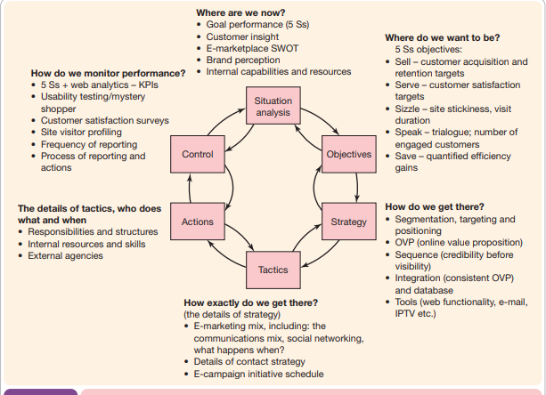

Slide 31
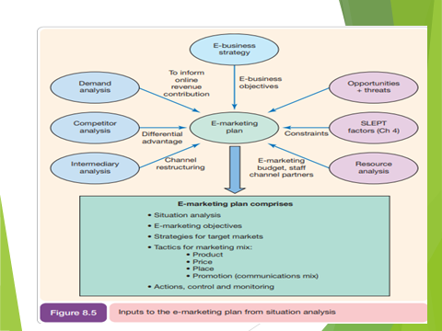

Slide 32
The 4 Ps from a customer perspective.
_x0002_ Customer needs and wants (from the product) – the web site is a mechanism for explaining how the product proposition meets these needs and wants. _x0002_
Cost to the customer (price) – online the customer is likely to be comparing prices to other web sites and traditional purchasing sources. _x0002_
Convenience (relative to place) – online this is the quality of customer experience in terms of the ordering process and fulfilment. _x0002_
Communication (promotion) – the web site itself coupled with the methods of driving traffic to the site, such as search-engine marketing and e-mail marketing

Slide 33
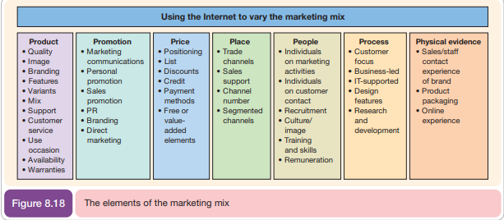

Slide 34
Customer relationship management (CRM)
Learning outcomes
Outline different methods of acquiring customers via electronic media
Evaluate different buyer behaviour amongst online customers
Describe techniques for retaining customers and cross-and up-selling using new media.

Slide 35
Management issues
What is the balance between online and offline investment for customer acquisition?
What technologies can be used to build and maintain the online relationship?
How do we deliver superior service quality to build and maintain relationships?

Slide 36
E-CRM – a definition
E-CRM is:
Applying –
Internet and other digital technology…
(web, e-mail, wireless, iTV, databases)
To –
acquire and retain customers
(through a multi-channel buying process
and customer lifecycle)
By –
Improving customer knowledge, targeting,
service delivery and satisfaction.

Slide 37
Marketing applications of CRM
A CRM system supports the following marketing applications:
Sales force automation (SFA). Sales representatives are supported in their account management through tools to arrange and record customer visits.
Customer service management. Representatives in contact centres respond to customer requests for information by using an intranet to access databases containing information on the customer, products and previous queries.
Managing the sales process. This can be achieved through e-commerce sites, or in a B2B context by supporting sales representatives by recording the sales process (SFA).
Campaign management. Managing ad, direct mail, e-mail and other campaigns.
Analysis. Through technologies such as data warehouses and approaches such as data mining, which are explained later in the chapter, customers’ characteristics, their purchase behaviour and campaigns can be analysed in order to optimize the marketing mix.

Slide 38
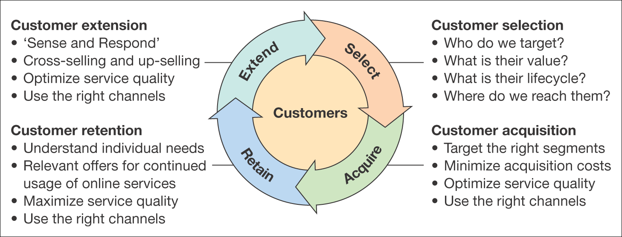
Figure 9.1 The four classic marketing activities of customer relationship management

Slide 39
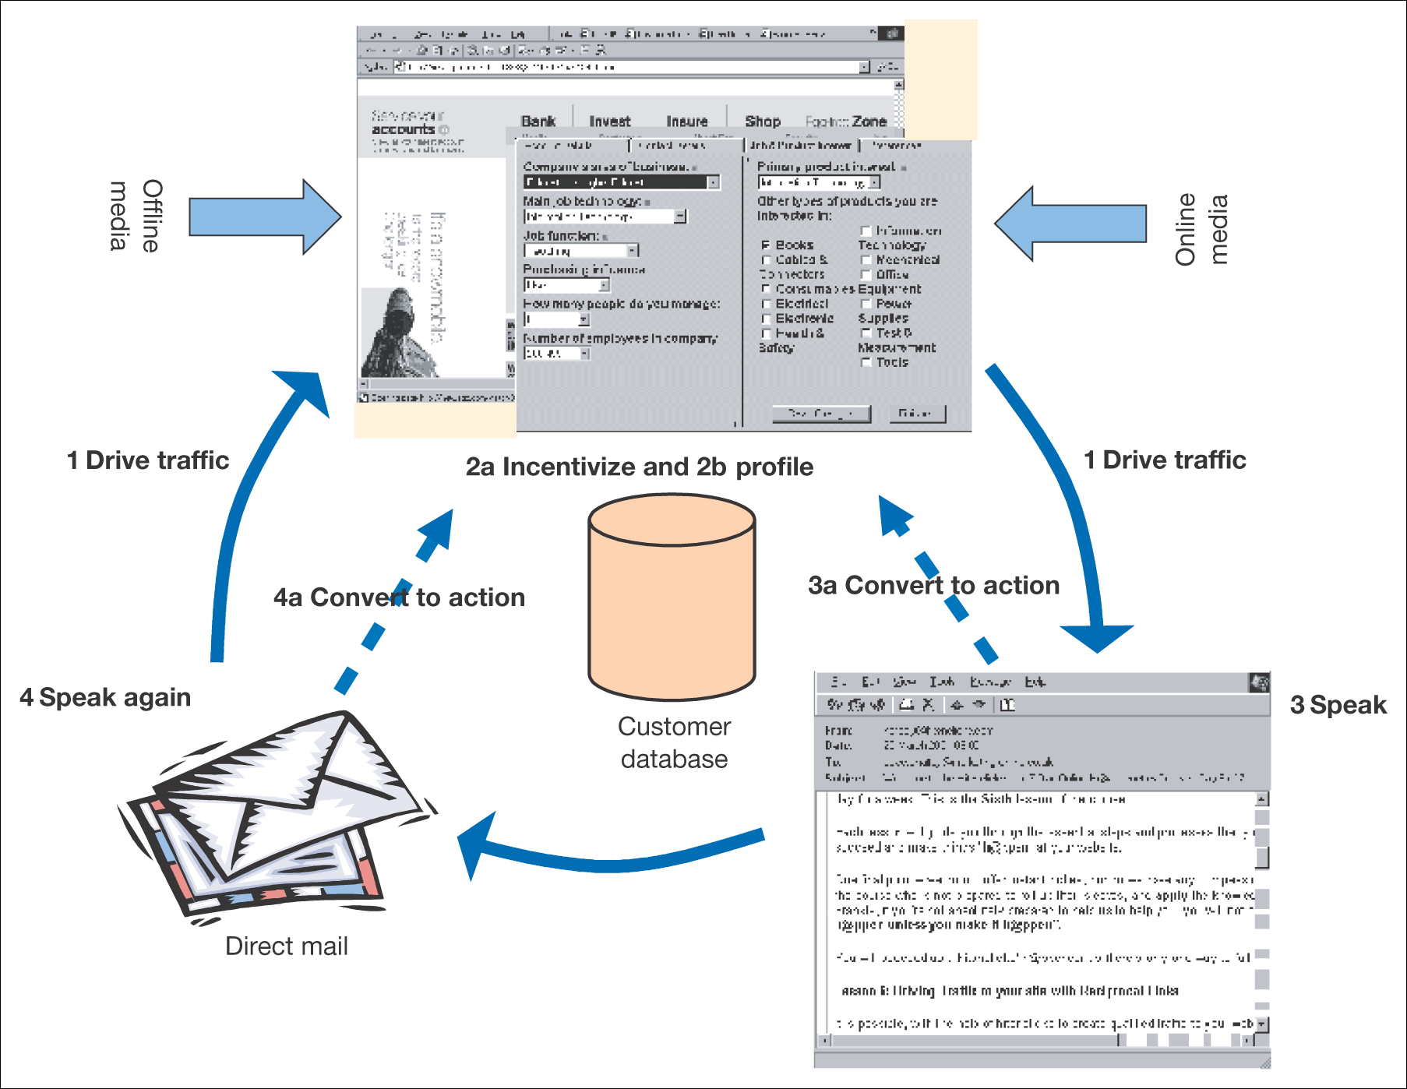
Figure 9.2 A summary of an effective process of online relationship building

Slide 40
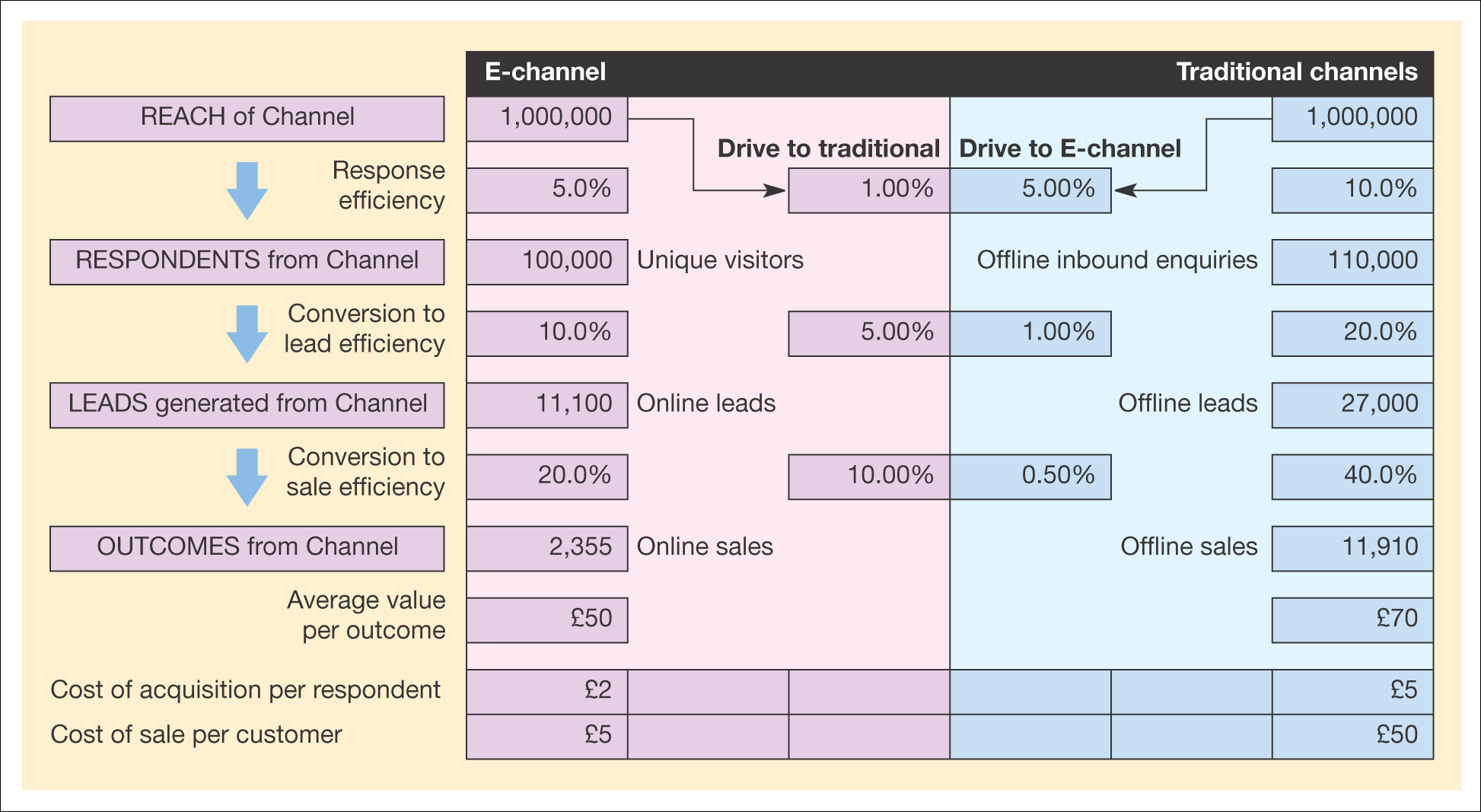
Figure 9.3 Multi-channel conversion model

Slide 41
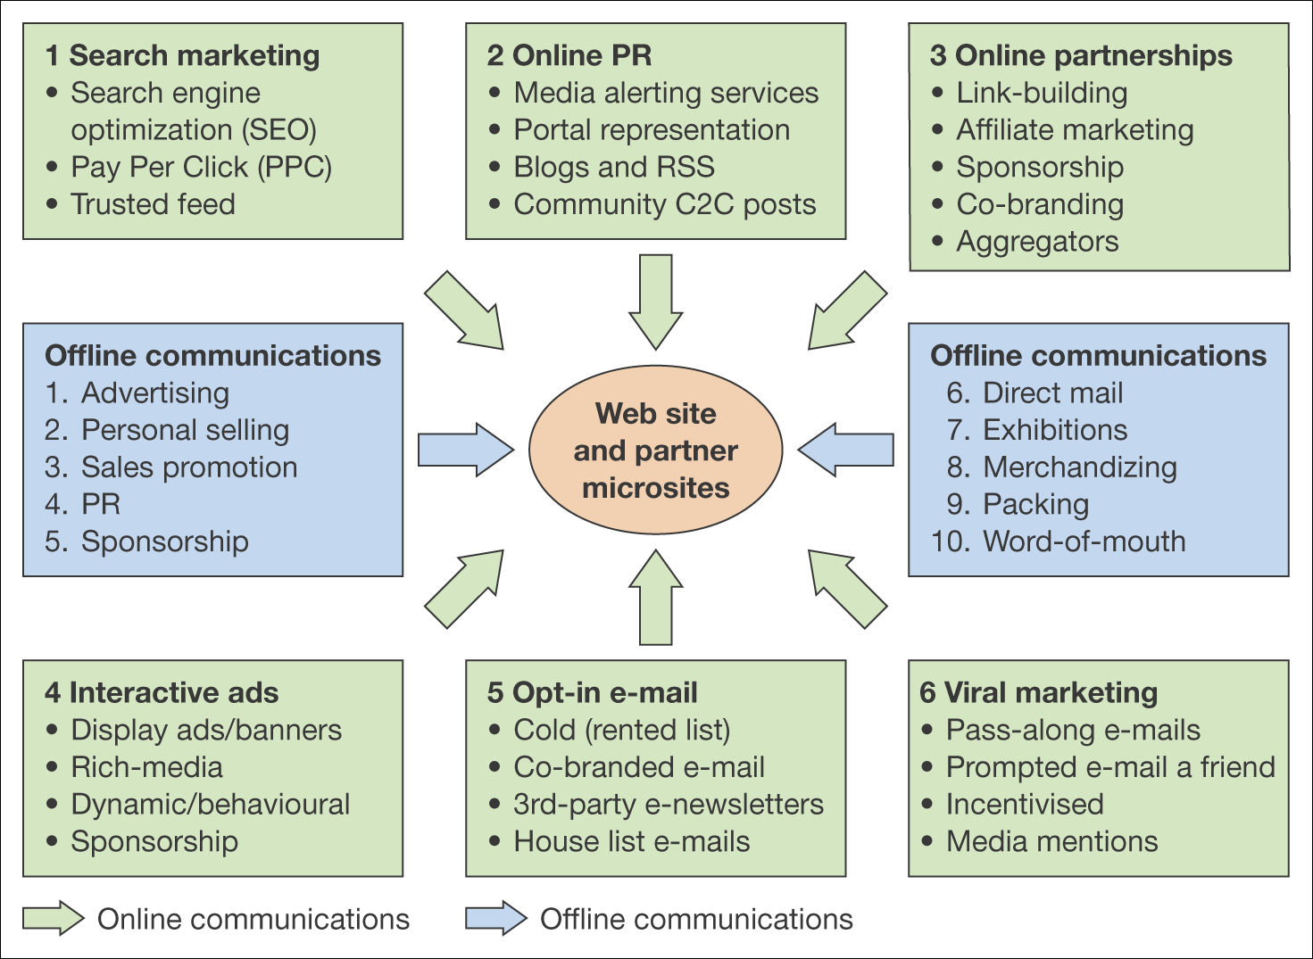
Figure 9.4 Online and offline communications techniques for e-commerce

Slide 42
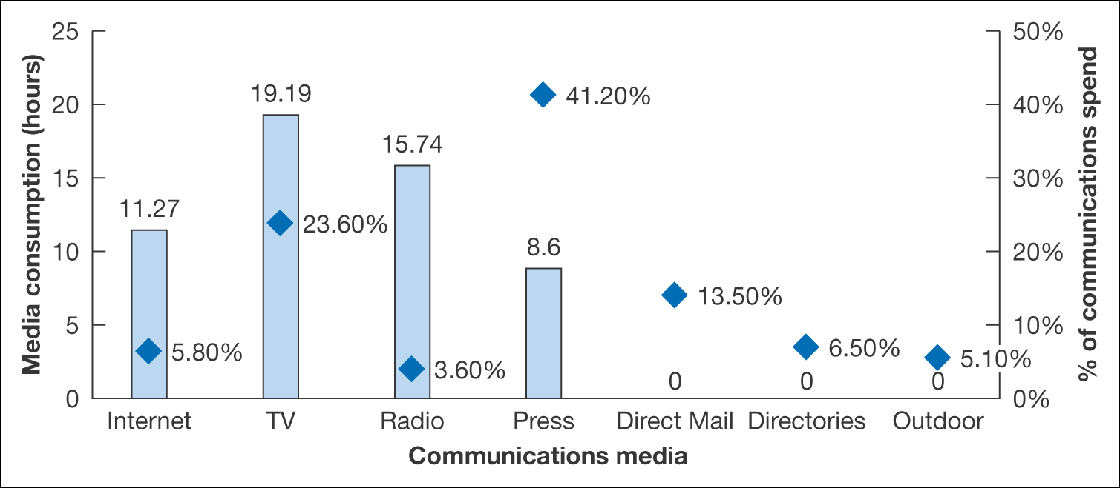
Figure 9.5 Variation in UK media consumption in hours (bars) compared to
percentage media expenditure (squares)
Source: Compiled from EIAA (2005) and IAB (2005)

Slide 43
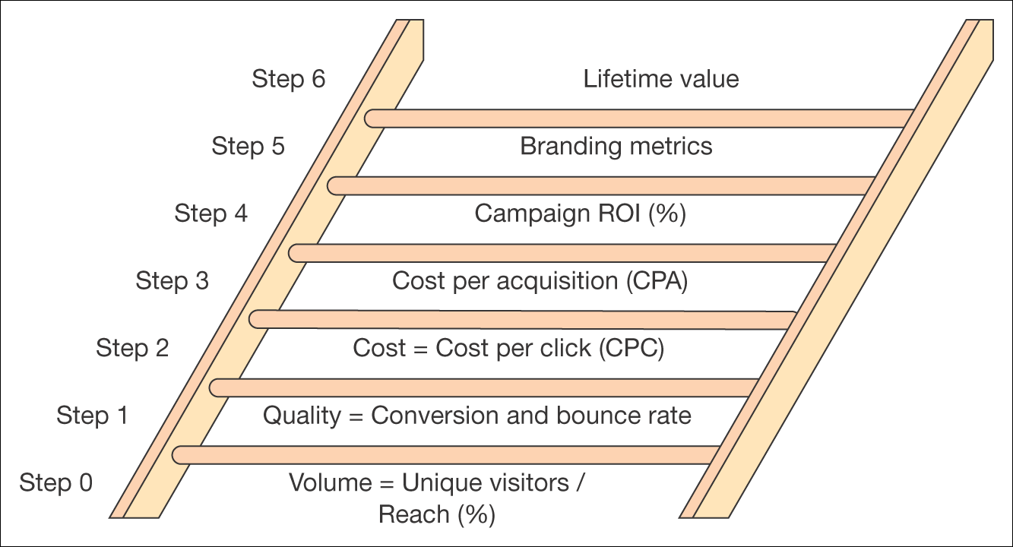
Figure 9.6 Measures used for setting campaign objectives or assessing campaign success increasing in sophistication from bottom to top

Slide 44
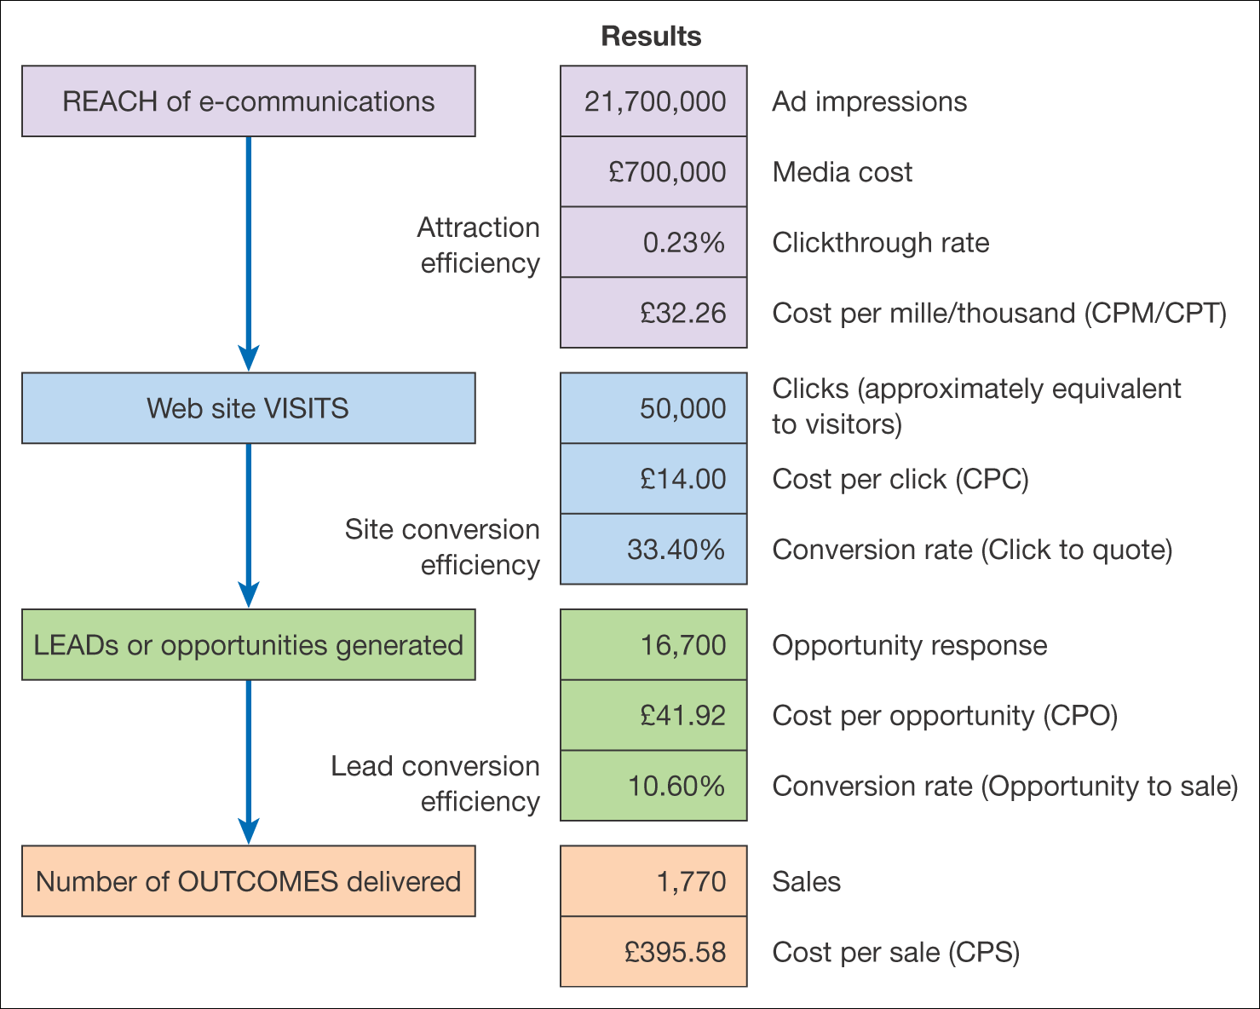
Figure 9.7 An example of effectiveness measures for an online ad campaign

Slide 45
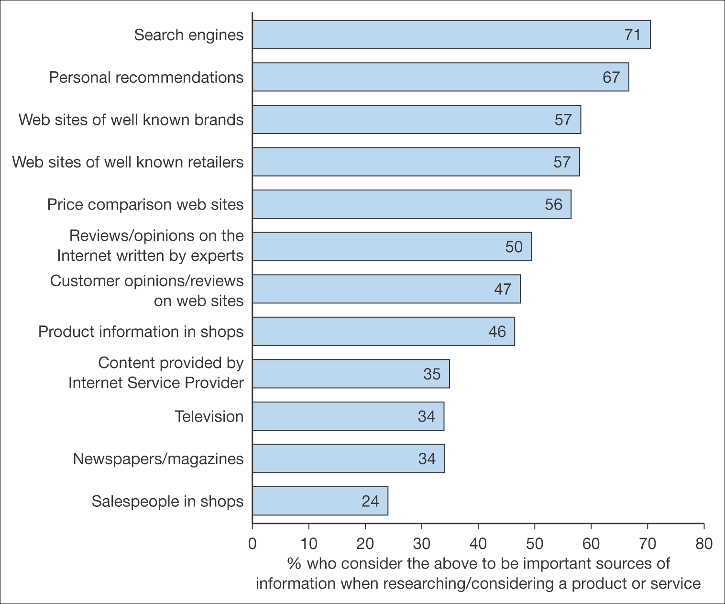
Figure 9.8 Percentage who consider the different information sources as important when researching/considering a product or service
Source: BrandNewWorld: AOL UK/Anne Molen (Cranfield School of Management)/Henley Centre, 2004

Slide 46
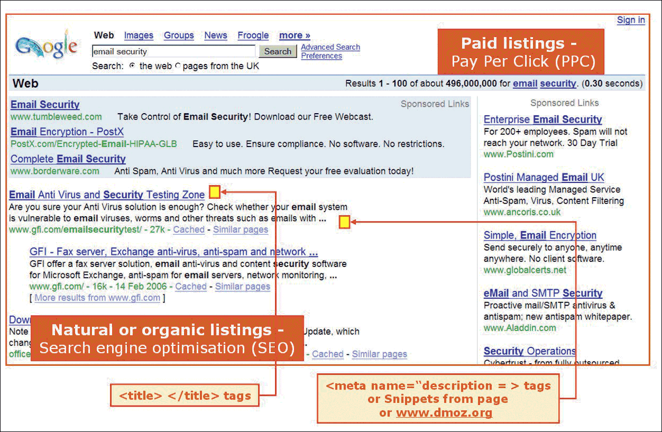
Figure 9.9 Search engine results page showing the two main methods for achieving visibility
Source: Screenshot reprinted by permission of Google, Inc

Slide 47
